Slide 1
Query Execution

Slide 2
Query Plans

Slide 3
How do queries Execute?
Plan is generated
Execution engine waits for resources
Enough memory (space to execute the query) – not fifo
Available scheduler (CPU)

Slide 4
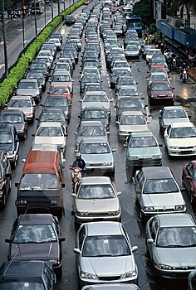
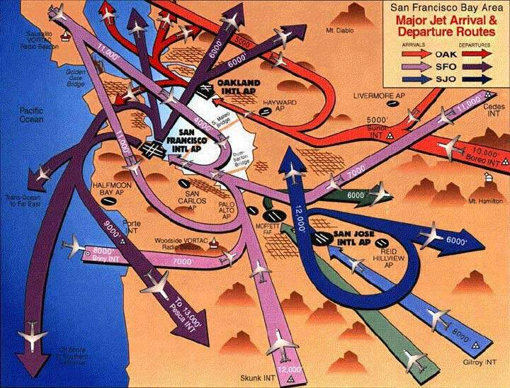

Understanding resources
Notes:
Cars queue in order for each CPU – they can switch lanes if one is moving faster. The motorbike could be in a separate resource governor pool.
The beach is like memory, if its full we can’t grant the execution space required and must wait (Memory Grant Pending)
Map of flight paths is like acquiring locks, we must follow a path (hierarchy) to reduce the chance of collisions – this causes queueing. Not just data pages but system pages in tempdb.
No mention of disk – all we care about here is memory

Slide 5
What is a Plan?
Calculated method to complete a given task
How?
Indexes
Statistics
Hints
Estimated Plans vs Actual Plans
Actually the same thing, one just has the actual counts/cost during execution

Slide 6
Query Plans
Cost
Operators
Seeks/Scans
Joins
Sorting
Calculations
Indexing
Covering indexes
Sort order
Estimation

Slide 7
Cost
Is based on a machine many years ago
Doesn't equate to anything specific
Useful for comparison
Shouldn't be used in isolation
Doesn't consider server state
Available memory
Pages in memory already
High end disk (ram disk, SSD)

Slide 8
Building a Plan
Seek vs Scan
Choosing an Index
Cardinality
Covering vs Non Covering
Filtered Indexes

Slide 9
Estimates
Plans are based on estimates
Based on statistics or fixed estimates
Statistics need updating
Especially where distributions change
i.e. time based data
Query has to run to get actuals

Slide 10
Statistics
Histogram of column(s) contents
Calculates the cardinality of a column (uniqueness of values)
Estimated from a sample (usually)
Always exist for indexes
Auto generated (usually) on other columns if used as predicates
Never auto generated on multiple columns (except indexes)
Manually update with UPDATE STATISTICS

Slide 11
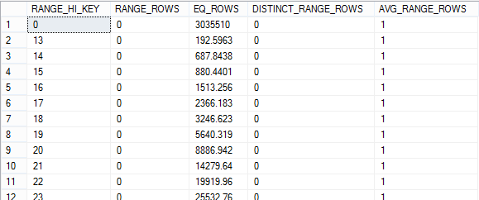
DBCC SHOW_STATISTICS
Notes:
Simple example where the number of distinct values in the column is low, but the number of matching records is high

Slide 12
Statistics Histogram
Notes:
Histogram shows skew for values between 160 and 175. If the plan is generated from a value in this range then it maybe off
Maximum 200 ranges calculated

Slide 13
Statistics Again
The tipping point
At some point SQL will estimate that it is quicker/more efficient to scan an table rather than seek on a index
Usually around 30% of the pages in the table are being read
Varies based on parallelism
Or, memory pressure
Never happens on a covering non clustered index

Slide 14
Plan Reuse

Slide 15
Why plan reuse
Compilation can take longer than execution time
We want predictable results
Use our memory for data and not adhoc plans

Slide 16
Plan reuse
Reuse
Guaranteed plan
Sub optimal
No reuse
Execution time Compile
Optimal plan
Plan cache bloat
Notes:
If execution time much > than compile time, why worry - > plan bloat
If execution time < compile time then really worry about it.
OLTP plan reuse
ETL, Reporting plan no reuse

Slide 17
Parameterisation
Query:
SELECT * FROM Sales WHERE SaleID = 1001
Becomes:
SELECT * FROM Sales WHERE SaleID = @p1
This increases the chance of a cache hit and reduces memory usage
Forced Parameterization
Works on literal strings
Will parameterize more queries
But will increase chances of wrong plan

Slide 18
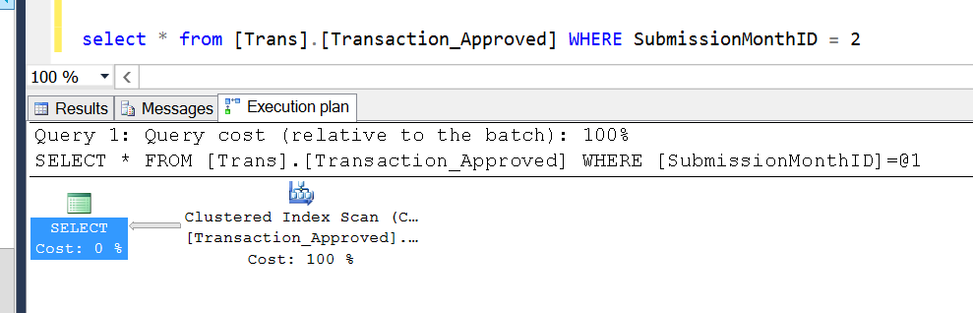
Parametrisation Example

Slide 19
Plan Caching
Creating plans is slow/expensive in an OLTP world
Not so much of an issue for data warehouses
sys.dm_exec_cached_plans - View
sys.dm_exec_query_plan - Function

Slide 20
Bad plans
Skewed data
Parameter value not sniffed
Look for
Differing Actual v Estimate
Loop joins
Large reads/cpu
Odd behaviour
Look in DMVs for plans, running code in SSMS may result in a new good plan

Slide 21
ORMs
nHiberbate/Linq
Adhoc Plan Caching
Server setting to cache on 2nd execution only to save memory

Slide 22
When do plans change?
Statistics Change
Different SET options - DBCC USEROPTIONS()
Object Changed
Forced Recompile
Server restart will clear plan cache

Slide 23
Demo – Arithabort On/Off

Slide 24
Parallelism
The use of multiple cpus/cores
Controlled by server level configuration
Overwritten by query hint (MAXDOP)
Not always possible
Distinct Count
Not always wanted
Skewed statistics leads to uneven threads (CXPACKET)

Slide 25
Foreign Keys
Views that have unnecessary joins can slow queries if:
They are missing Foreign Keys
Or, the Foreign key is untrusted
By having trusted keys the join does not need to be checked when not in use

Slide 26
Plan Operators

Slide 27
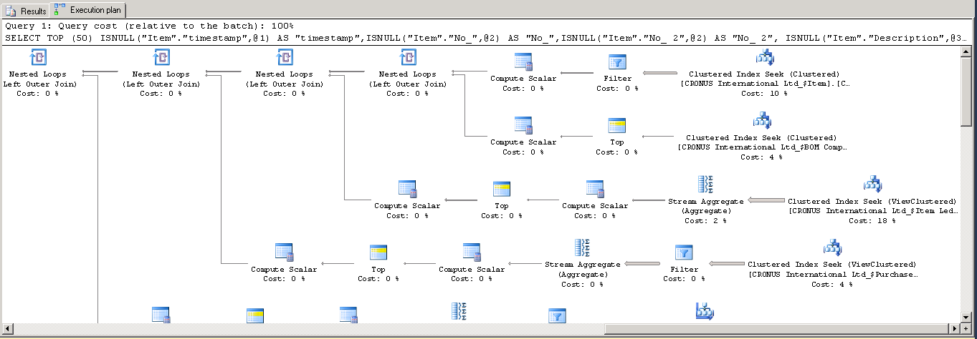
What do all these things mean?

Slide 28


Seeks and Scans
Seek
Usually preferred
Fast - direct to an index key
Scan
Reads all data in the table or a range
Slower if looking for a limited set of results

Slide 29



Join Types
LOOP
Fast for small datasets
Used for bookmark lookups
Bad is wrong estimates
MERGE
Very fast
Requires both sides to be sorted
HASH
Hashes data, heavy on CPU/tempdb
Best for very large joins

Slide 30



Costly Operators
Sort
Slow
Sometimes required for merge joins
Bookmark Lookup
Non clustered index is not covering
Spools (several variations)
Storing working in tempdb

Slide 31
Demo
Finding a plan
Viewing the plan
Looking at the memory grant & cost

Slide 33
Hints

Slide 34
Hints
RECOMPILE/With Recompile
Prevents the plan from being cached
Parameterization will not take place
FORCE ORDER
FORCE SEEK/SCAN
MAXDOP
INDEX [IndexName]
UNKNOWN

